Slide 1

Financial (Expense) Management Application
“Beware of little expenses!!!!!!
A small leak will sink a ship”

Slide 2
Why do we need to manage our finance expenses?
1. Achieve Financial Stability & Goals
Live within your means:
Managing expenses helps you understand your income and spending, ensuring you don't spend more than you earn.
Reach financial goals:
Whether it's saving for a car, a home, or retirement, controlling your spending frees
up money to put towards these goals.

Slide 3
Build wealth:
By consistently saving and investing money that would otherwise be spent on non-essentials, you can grow your wealth over time.
2. Build Security & Reduce Stress Create an emergency fund:
A budget helps you set aside money for unexpected events like job loss, illness, or home repairs, providing peace of mind.
3. Prevent Debt & Overspending
Avoid unnecessary debt:
By monitoring spending, you're less likely to make impulsive purchases or take on debt that you can't manage.
Manage existing debt :If you have debt, a budget helps you allocate funds to pay it off systematically.
Discourage lifestyle inflation : Budgeting helps you resist the tendency to increase spending in proportion to rising income, directing more money toward savings instead.
4. Cultivate Healthy Financial Habits
Develop discipline : Managing expenses requires discipline and mindful spending, which are valuable habits for long-term financial success.
Prioritize spending : You learn to differentiate between your needs and wants, making conscious decisions about where your money goes based on your values and goals.

Slide 4
Group Name:- Cash Crafters
Group Members:-
*ANANYA ANIL-25BAS10046
*BHUMIKA GAUTAM-25BCE10831
*RIYA GUPTA-25BET10051
*SUKRITI JAISWAL-25MIM10060
*SAIYAM JAIN-25BAI10938

Slide 5
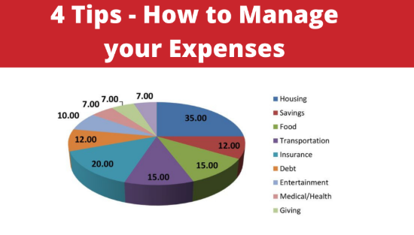

Slide 6
What are we up to!!!!!!!!
We are going to use MySQL(Structured Query Language) for storing the data and Python for programming.
First we created a database and then created required tables for storing the data in MySQL.
We will store all the data in it which we have gathered. Data will be collected from internet, articles, newspapers etc.
We will then write python programs to do the required task as mentioned.
Establish connection between MySQL and Python. Then do the necessary updates.

Slide 7
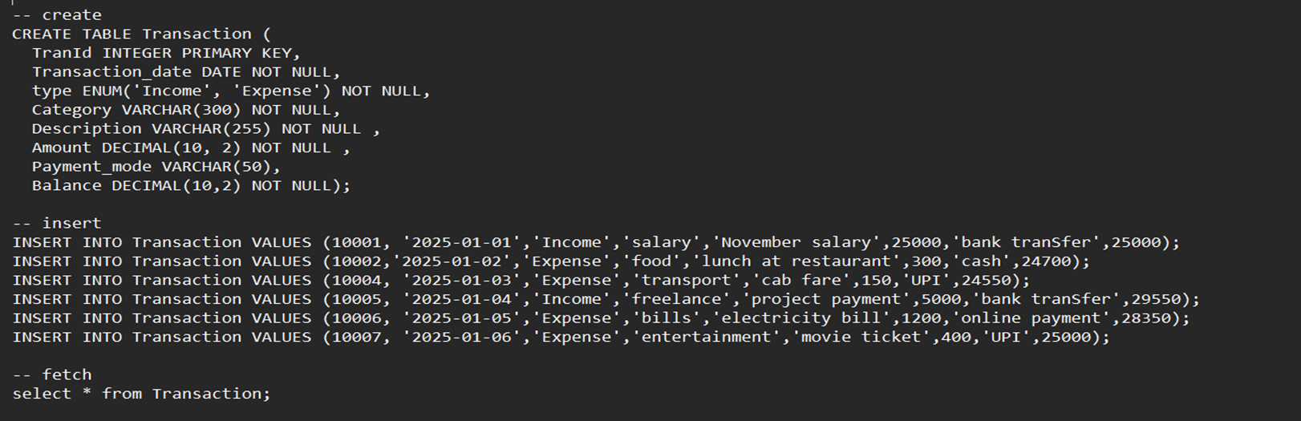
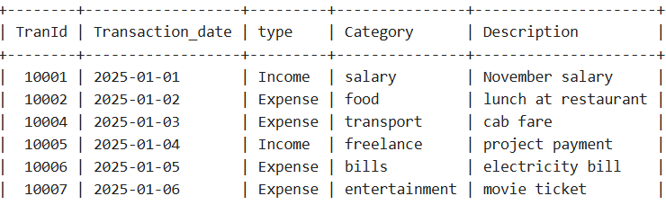
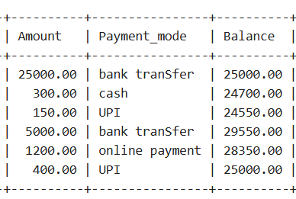
It is a sample code and its output done in MySQL for displaying the stored data.
It

Slide 8
Project Features
• Add, update, delete income/expense
• Categorization
• View summaries and reports
• Data storage
• Search option
#Features which are completed:
1) Categorization of income and expenses.
#Features which are in progress:
1) Data collection and storing process in MySQL.
#Features which are yet to start:
Add, update, delete income/expense
View summaries and reports
Search option

Slide 9
Technologies Used
• Programming language –Python
• File/database usage-MySQL
• UI type –Web
Current Progress
1)Learning process of using MySQL efficiently is going on.
2)Collection of data.
3)Collected data is being stored in MySQL.
4)Checking other possibilities of categorization.

Slide 10
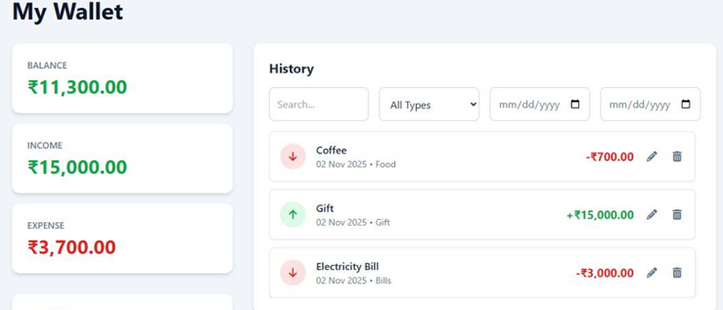
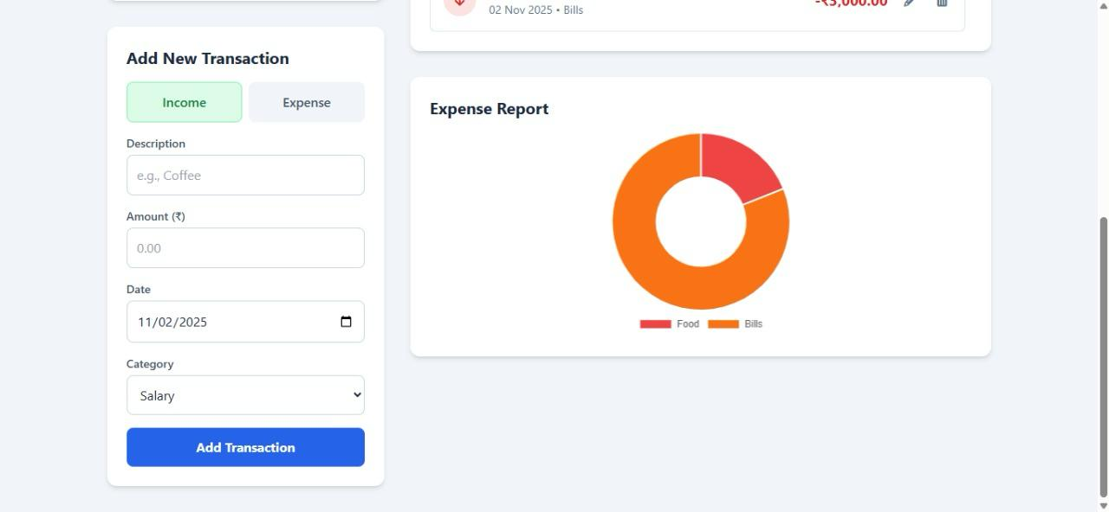
Screenshots of UI

Slide 11
CHALLENGES FACED
Technical Problems:
Issues with data storage and file handling.
Sometimes the code didn’t work properly when we ran it.
Fixing these technical issues took some time and testing.
Database or File Handling Difficulty:
We used a MySQL file to store data. We faced problem in setting up and downloading MySQL .
It was really difficult to write the codes and it’s execution.
Team Coordination Challenges:
It was really hard to combine everyone’s work into one.
We had to communicate and test together to make sure everything is working smoothly.

